Slide 1
Devnath R
2021506016
B.Tech Information Technology
Madras Institute of Technology
TNSDC - Machine Learning to
Generative AI
Final Project
DATE:14/04/2024

Slide 2
PROJECT TITLE
"Screen Sentiments: Unraveling IMDb Movie Reviews with CNN-based Sentiment Analysis”
GITHUB LINK: https://github.com/devnath2099/tnsdc_genai.git

Slide 3


AGENDA
Problem Statement
Project Overview
Objectives
End Users
Solution and Value Proposition
Model Explanation
Results
Conclusion
3/21/2024 Annual Review

Slide 4

PROBLEM STATEMENT
The problem entails the development of an effective sentiment analysis system using Convolutional Neural Networks (CNNs) specifically tailored for IMDb Movie Reviews.
The objective is to accurately categorize the sentiment expressed in user-generated reviews as positive, negative, or neutral, addressing the challenges posed by the nuanced language and diverse emotions prevalent in movie critiques.

Slide 5

PROJECT OVERVIEW
This project focuses on conducting sentiment analysis of IMDb movie reviews using Convolutional Neural Networks (CNNs). IMDb serves as a rich repository of user-generated reviews expressing diverse sentiments towards movies. By employing advanced deep learning techniques, this project aims to extract meaningful insights from these reviews to understand audience sentiments more accurately.

Slide 6
OBJECTIVES
Develop a CNN-based sentiment analysis model optimized for IMDb movie reviews.
Preprocess IMDb movie review data to enhance model training efficiency.
Train and fine-tune the CNN model to accurately classify sentiment polarity.
Evaluate the model's performance using metrics such as accuracy, precision, recall, and F1-score.
Present the results effectively using visual aids such as confusion matrices and ROC curves.

Slide 7
WHO ARE THE END USERS?
The main end users are Film makers, producers , film enthusiasts and Streaming Platforms.
Filmmakers and producers use sentiment analysis to understand audience reactions, inform marketing, and guide content creation.
Movie enthusiasts benefit from accurate sentiment analysis to choose movies.
Streaming platforms improve user satisfaction with personalized recommendations.

Slide 8

YOUR SOLUTION AND ITS VALUE PROPOSITION
Our solution uses Convolutional Neural Networks (CNNs) to provide highly accurate IMDb sentiment analysis. By automatically decoding nuanced emotions in movie reviews, it empowers entertainment industry decision-makers with actionable insights. Its simplicity and accuracy elevate IMDb sentiment analysis, delivering tangible value to stakeholders aiming to connect authentically with their audience.

Slide 9
THE WOW IN SOLUTION
Our solution's "wow" factor lies in leveraging Convolutional Neural Networks (CNNs) for IMDb sentiment analysis. CNNs excel in automatically learning intricate patterns within textual data, ensuring unparalleled accuracy in discerning nuanced sentiments from movie reviews. Their hierarchical feature extraction and flexibility in handling variable-length inputs set a new standard for precision and insight in sentiment analysis.

Slide 10
MODELLING
In this project, a Convolutional Neural Network (CNN) architecture is employed for sentiment analysis of IMDb movie reviews. The CNN model processes sequences of tokens representing words in the reviews. Initially, an embedding layer maps these tokens to high-dimensional vectors, learning contextual representations for words. Subsequent convolutional layers apply filters to capture local patterns and relationships between words, while max-pooling layers reduce dimensionality, retaining relevant information. Flattening and fully connected layers perform classification based on the extracted features, producing sentiment probabilities for each review.

Slide 11
MODELLING
The CNN architecture enables effective feature extraction from textual data, crucial for sentiment analysis. By leveraging convolutional and pooling operations, the model captures intricate patterns and relationships within movie reviews, allowing it to discern nuanced sentiments accurately. Dropout layers mitigate overfitting, ensuring the model's generalization capability. During training, the CNN model learns to minimize a loss function by adjusting parameters through optimization algorithms, facilitating the development of robust sentiment analysis capabilities.

Slide 12
MODELLING
The CNN architecture enables effective feature extraction from textual data, crucial for sentiment analysis. By leveraging convolutional and pooling operations, the model captures intricate patterns and relationships within movie reviews, allowing it to discern nuanced sentiments accurately. Dropout layers mitigate overfitting, ensuring the model's generalization capability. During training, the CNN model learns to minimize a loss function by adjusting parameters through optimization algorithms, facilitating the development of robust sentiment analysis capabilities.

Slide 13
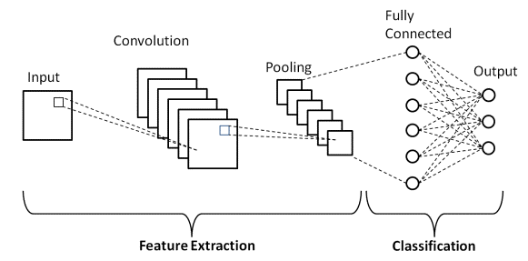
CNN ARCHITECTURE

Slide 14
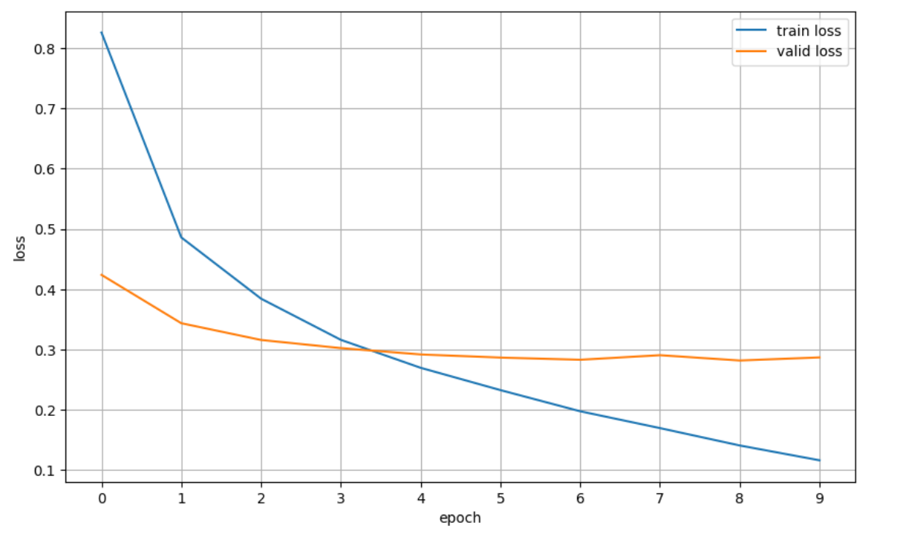
RESULTS

Slide 15
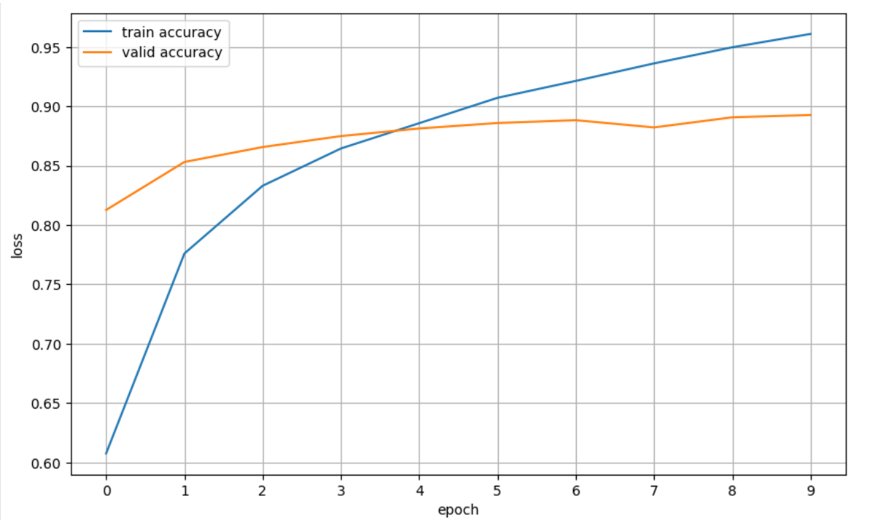
RESULTS

Slide 16
CONCLUSION
In summary, CNN-based sentiment analysis offers a potent solution for
decoding IMDb movie reviews, effectively capturing nuanced sentiments.
By leveraging deep learning techniques, it empowers stakeholders with
actionable insights, enhancing decision-making in the entertainment industry.
This approach exemplifies the efficacy of CNNs in uncovering
complex sentiments within textual data, heralding a new era
of data-driven analysis in digital entertainment.

